Slide 1

Highlights for clinical practice Renal Cell Carcinoma
ESMO Congress
Barcelona, Spain
13 – 17 September 2024
CBZ-BE-001232 OCTOBER 2024

Slide 2
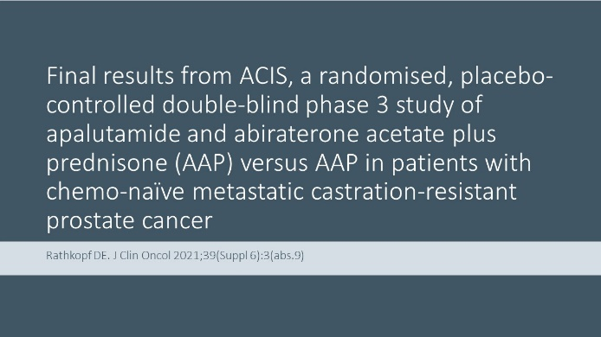
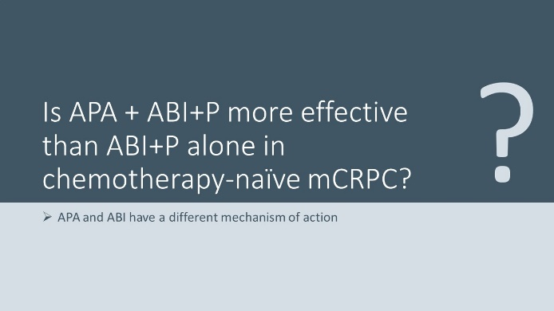
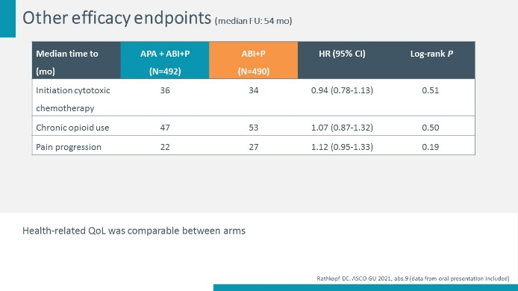
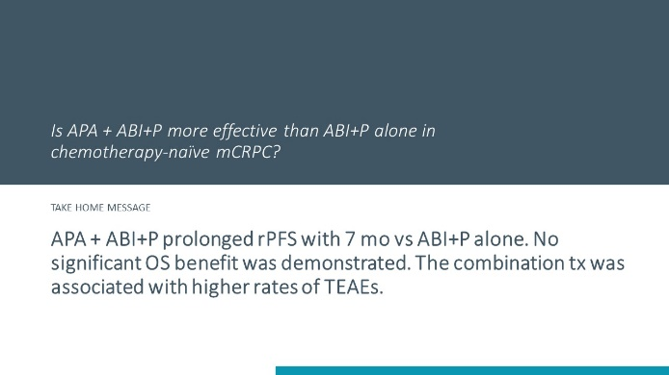
Structure of slide deck
First slide (hidden)
Second slide
Following slide(s)
Final slide
Topic (often title of the abstract) + reference Note pages contain abstract
Clinical question whereon selection is based + background of the question
Description of abstract: study design + efficacy + safety data
Repetition of clinical question + answer (take home message)
Notes:
Slides are thematically structured.
The slide can contain data from posters and/or presentations (indicated after the reference; bottom right of the slide), which can differ from data in the abstract.
Note pages provide explanation of abbreviations and clinical relevance comments.
To explain how the presented data can impact clinical practice, a clinical question is formulated before the evidence slides. On the final slide this clinical question is repeated and a take home message/answer is provided. This answer is not necessarily the same as the conclusion of the authors of the abstract.
Comments of the experts who selected and/or reviewed these slides are grouped in the note page of the final slide with the take home message.”

Slide 3
Disclaimer Issecam
These slides may not be published or posted online without permission from the publisher e-hims (can be requested by email info@e-hims.com).
When using our slides, please retain the source attribution and/or refer to ISSECAM Forum GU Oncology.
The information on the slides included is not intended to replace professional guidelines or established clinical practice.
Concerning medical treatment options, the approved summary of product characteristics should be used for guidance.
This independent medical education programme is financially supported by Ipsen.

Slide 4
Disclaimer Ipsen
Slide kit developed by Issecam and created by the Issecam Forum GU Oncology. To be used solely by IPSEN in Belgium. NOT FOR DISTRIBUTION.
The opinion and views expressed in this presentation are those of the writers and do not necessarily constitute the opinions or recommendations of Ipsen.
The scientific information may include data / information on drugs that have not yet received price and reimbursement approval by local regulatory authorities, please consult the corresponding local SmPC for further information.
Conflict of interest
Issecam is a multidisciplinary, nonprofit scientific association with a main focus on improving clinical decision making, targeting better patient outcomes.
No conflicts of interest.

Slide 5
Conflicts of interest
Reporters (selection abstracts + review)
Daan De Maeseneer AZ Sint-Lucas, BE | Honoraria or consultation fees: Ipsen, Janssen, Merck, MSD, Pfizer, Sanofi, TEVA; Receipt of grants/research supports: Roche (unrestricted research grant)
Javier Puente Hospital Universitario Clinico San Carlos, SP | Honoraria for speaker engagements, advisory roles or continuous medical education: Astellas, AstraZeneca, Bayer, BMS, Eisai, Ipsen, Janssen, Merck, MSD, Pfizer, Pierre Fabre, Roche, Sanofi; Research funding: Astellas, Pfizer; Consultant: Astellas, Roche
Editorial board (review)
Philippe Barthélémy Institut de Cancérologie Strasbourg, FR | Honorarium for speaker engagements, advisory roles or continuous medical education: Astellas, AstraZeneca, Bayer, BMS, Eisai, Ipsen, Janssen, Merck, MSD, Pfizer, Accord Health Research funding: Ipsen, BMS
Alberto Lapini Careggi Hospital, IT | Advisory board: Astellas, Bayer, Janssen
Arnoud J. Templeton St. Claraspital, CH | Consulting fees: Roche (I) and Bayer (I). Honoraria: Astellas (P, I), Janssen (P, I), MSD (I), SAKK (P). Advisory boards: MSD (P, I), Sanofi (I), Roche (I), Janssen (I), Bayer (I), Pfizer (I), Ipsen (I), Sandoz (I), BMS (I). Conference/travel support: Roche (P) and Orion Pharma (P) (I=institutional, P=personal)

Slide 6
Glossary RCC (A-O)
AE | adverse event
ADR | adverse drug reaction
ALT | alanine aminotransferase
AST | aspartate transaminase
AVE | avelumab
AXI | axitinib
BOR | best overall response rate
BICR | blinded independent central review
bid | twice daily
CABO | cabozantinib
C(avgd28) | average serum concentration over 28 days
ccRCC | clear-cell renal cell carcinoma
CI | confidence interval
C(minss) | minimum serum concentration at steady state
CPS | combined positive score
CR | complete response
DCR | disease control rate
DOR | duration of response
ECOG PS | Eastern Cooperative Oncology Group performance status
EVE | everolimus
FA | Final analysis
FMT | faecal microbiota transplantation
FU | follow-up
HIF | hypoxia-inducible factor
HR | hazard ratio
ICI | immune checkpoint inhibitor
ICR | independent central review
IMDC | International Metastatic RCC Database Consortium
IPI | ipilimumab
IQR | interquartile range
irAE | immune-related adverse event
IRR | independent radiology review
ISUP | The International Society of Urological Pathology
ITT | intention to treat
iv | intravenously
KPS | Karnofsky Performance Score
LEN | lenvatinib
LN | lymph node
mets | metastases
monotx | monotherapy
NA | not applicable
NC | not calculable
NE | non estimable
NIVO | nivolumab
NR | not reached
ORR | objective/overall response rate
OS | overall survival

Slide 7
Glossary RCC (P-Z)
PAZO | pazopanib
PBO | placebo
PD | progressive disease
PD-(L)1 | programmed death (ligand) 1
PEMBRO | pembrolizumab
PFS | progression-free survival
PR | partial response
pts | patients
qd | every day
QoL | quality of life
qXw | every X weeks
R | randomised
RCC | renal cell carcinoma
RECIST | Response Evaluation Criteria In Solid Tumours
rHuPH20 | recombinant human hyaluronidase PH20
sc | subcutaneous
SD | stable disease
SOC | standard of care
SORA | sorafenib
SUN | sunitinib
TEAE | treatment-emergent adverse event
TIVO | tivozanib
TKI | tyrosine kinase inhibitor
TME | tumour microenvironment
TTR | time to treatment response
TTP | time to progression
TRAE | treatment-related adverse event
tx | treatment
VEGF(R) | vascular endothelial growth factor (receptor)

Slide 8
Management of advanced disease

Slide 9
Tivozanib-nivolumab vs tivozanib monotherapy in patients with renal cell carcinoma following 1 or 2 prior therapies including an immune checkpoint inhibitor: results of the phase III TiNivo-2 study
Choueiri TK. Ann Oncol 2024;35(Suppl 2):S1261(abs.LBA73)
Notes:
Background
The selective VEGFR TKI tivozanib has demonstrated single agent activity following VEGFR TKI and immune checkpoint inhibitor (ICI), and in combination with ICI. TiNivo-2 was designed to test the combination of the PD-1 inhibitor nivolumab and tivozanib vs tivozanib monotherapy following tumor progression on prior ICI-based therapy.
Material & methods
TiNivo-2 enrolled pts with advanced clear-cell renal cell carcinoma (RCC) who had 1–2 prior lines of therapy, including an ICI. Pts were randomized to receive tivozanib (0.89 mg) plus nivolumab or tivozanib alone (1.34 mg). The primary endpoint was PFS by independent radiology review (IRR); the key secondary endpoint was OS, other secondary endpoints included investigator-assessed PFS, ORR, DoR, and safety/tolerability. A sample size of 343 pts with 220 events provided ≥80% power to detect a 50% improvement in PFS, 12 m vs 8 m, assessed by IRR.
Results
343 pts were randomized to tivozanib–nivolumab (n=171) or tivozanib (n=172). Baseline characteristics were well balanced. With a median IRR-assessed PFS of 5.7 m for tivozanib–nivolumab and 7.4 m for tivozanib (HR 1.10 [95% CI 0.82. 1.43]), the study did not meet its primary endpoint. Among those with ICI as immediate prior therapy (n=244), mPFS was 7.4 m (95% CI, 5·55-9·56) with tivozanib–nivolumab and 9.2 m (95% CI, 7·43-9·99) with tivozanib. Data for subgroups and OS and ORR are in the table. 205 (60%) pts experienced a grade 3 or higher AE, the most common was hypertension (22% both arms; others <5%). AEs leading to death occurred in 7 (4.2%) pts with tivozanib–nivolumab and 5 (2.9%) with tivozanib; 1 (tivozanib arm) was deemed treatment related.
Conclusions
ICI combination rechallenge did not improve clinical outcomes, suggesting the avoidance of sequential ICI in advanced RCC outside of clinical trials. These results support tivozanib monotherapy at 1.34 mg daily as 2nd-line therapy for pts following progression on previous ICI combination therapy. Clinical trial identification: NCT04987203.

Slide 10
Is ICI rechallenge with TIVO+NIVO an option for pts with metastatic RCC following progression on prior ICI?
The ESMO guidelines recommend to treat pts, who progressed on ICI tx, with a VEGFR-TKI tx that has not been given previously; cabozantinib is preferred based on CONTACT-03
The CONTACT-03 trial failed to demonstrate benefit of ICI after ICI failure (ICI rechallenge)
Combining TIVO+NIVO showed a promising antitumour efficacy and AE profile in tx-naïve or previously treated metastatic RCC pts in the TiNivo trial
Notes:
Comments experts
CONTACT-03 trial: Pal SK et al. Lancet 2023;402(10397):185-95 [https://pubmed.ncbi.nlm.nih.gov/37290461/].
The results of phase 1/2 TiNivo study: Albiges L et al. Ann Oncol 2021;32:97-102 [https://pubmed.ncbi.nlm.nih.gov/33010459/].

Slide 11
TiNivo-2: randomised phase III trial
Population
Design
Endpoints
Locally advanced or metastatic ccRCC
Progression after 1-2 prior systemic tx, incl. 1 ICI
Progression during or after ≥6 wk of tx with ICI
Time from prior tx to randomisation ≤6 mo
Measurable disease (RECIST v1.1)
ECOG PS 0 or 1
28-d cycles
Coprimary
PFS by IRR
Secondary
OS
PFS by investigator
ORR
DOR
Safety
N=171
TIVO (0.89* mg po d1-21)
+
NIVO (480 mg iv, d1)
R
1:1
N=343
TIVO (1.34 mg po d1-21)
N=172
Stratification factors: IMDC risk score, prior tx (ICI as most recent tx or not)
IRR: independent radiology review
*Dose of TIVO in combination arm was reduced due to potential risk of higher rate of grade 3/4 hypertension
Choueiri TK. ESMO 2024, abs.LBA73 (data from oral presentation included)
Notes:
Comments experts
Clinicaltrials.gov identifier: NCT04987203.
Tx was continued until progression or unacceptable toxicity; NIVO was discontinued in all pts after 2 years of tx.
Stratification according to prior tx (ICI as most recent tx or not): to test if ICI break/resensitising the immune system to ICI tx impacts outcomes.
Discussant Manuela Schmidinger pointed out that the dose reduction of TIVO in the combi arm was agreed with authorities, but it is unlikely that hypertension would be more of an issue when TIVO is combined with NIVO. Hypertension is usually very well managed.

Slide 12
Baseline characteristics
 | TIVO+NIVO (N=171) | TIVO (N=172)
Median age (yr) | 64 | 63
Male (%) | 73 | 78
ECOG PS (%) 0 / 1 / NR | 44 / 55 / <1 | 49 / 51 / 0
IMDC risk group (%) Favourable Intermediate Poor | 18 67 16 | 18 66 16
Prior lines of tx: 1 / 2 (%) | 65 /35 | 61 / 39
Most recent tx (%) ICI / Non-ICI | 71 / 29 | 71 / 29
Prior VEGFR-TKI (%) 0 / 1 / 2 | 31 / 56 / 13 | 31 / 58 / 11
NR: not reported
Choueiri TK. ESMO 2024, abs.LBA73 (data from oral presentation included)
Notes:
Comments experts
About 1/3 of pts in both arms did not receive ICI as the most recent tx.
About 1/3 of pts in both arms did not receive prior VEGFR-TKI.

Slide 13
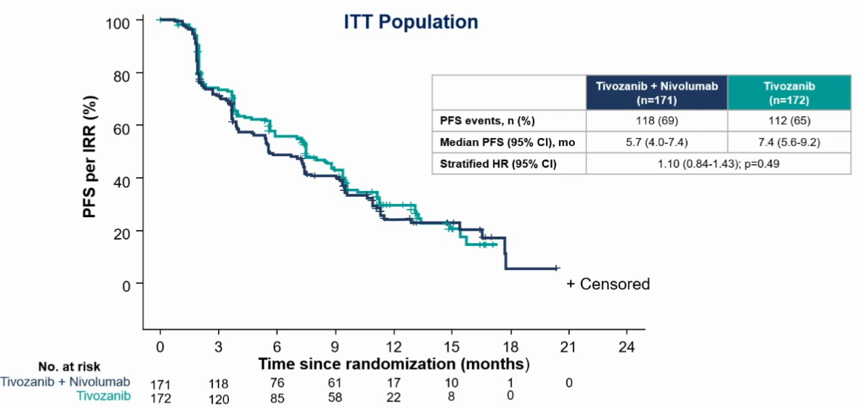
Primary endpoint: PFS by IRR (median FU: 12 mo for TIVO+NIVO and 13 mo for TIVO)
No PFS difference by line of tx (2nd- or 3rd-line tx)
No PFS difference by subgroup analysis
Choueiri TK. ESMO 2024, abs.LBA73 (data from oral presentation included) Permission for use granted by the presenter
Notes:
Comments experts
No subgroup was identified that benefitted from the addition of NIVO.
Data suggest that TIVO full dose seems to be crucial rather than reduced dose.

Slide 14
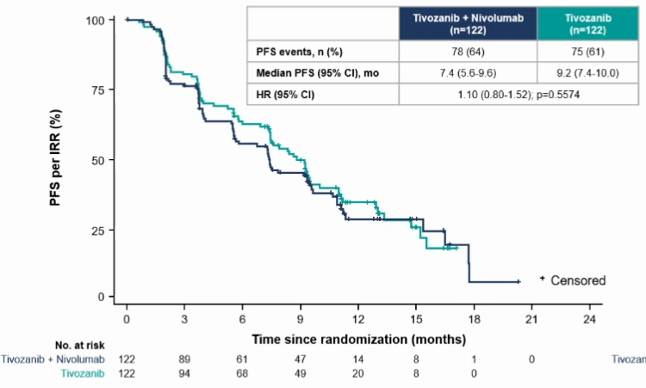
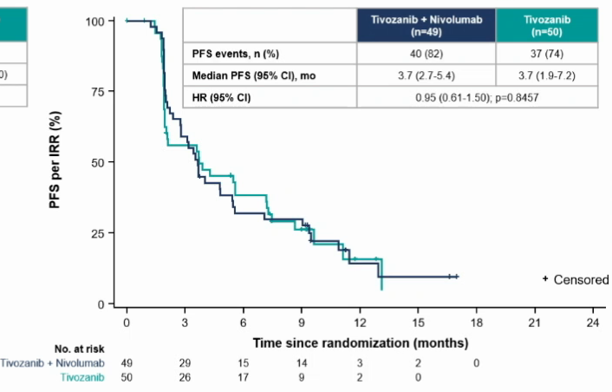
PFS by IRR by most recent tx line (median FU: 12 mo for TIVO+NIVO and 13 mo for TIVO)
ICI as most recent tx
Non-ICI as most recent tx
Choueiri TK. ESMO 2024, abs.LBA73 (data from oral presentation included) Permission for use granted by the presenter
Notes:
Comments experts
ICI tx after prior ICI is not effective, regardless of ICI or non-ICI being the most recent tx.

Slide 15
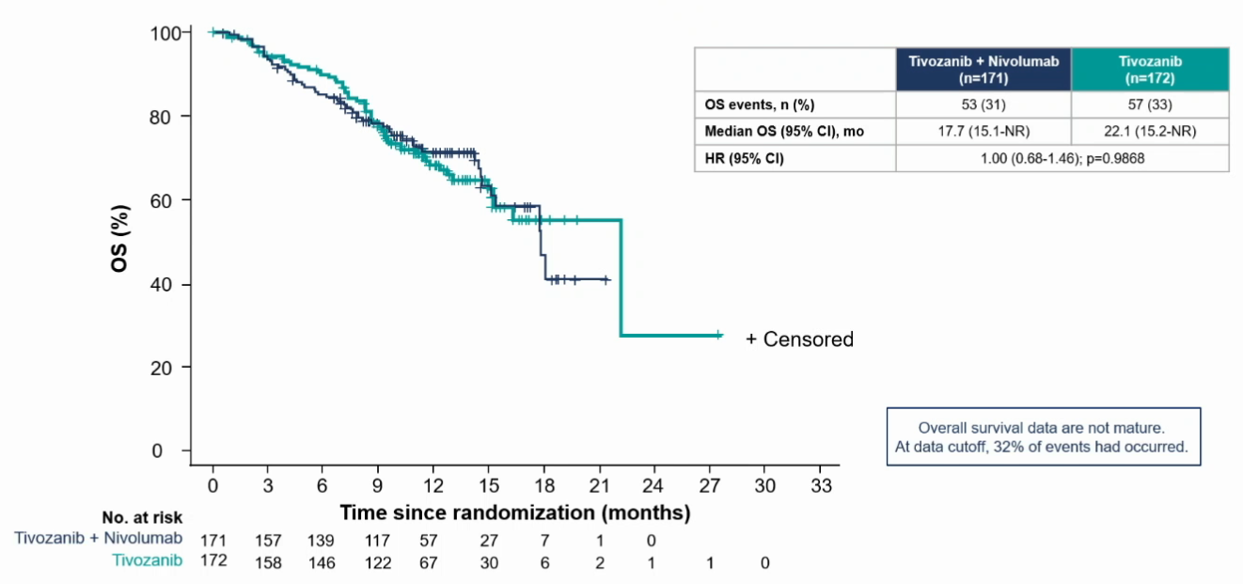
Secondary endpoint: OS (median FU: 12 mo for TIVO+NIVO and 13 mo for TIVO)
Choueiri TK. ESMO 2024, abs.LBA73 (data from oral presentation included) Permission for use granted by the presenter

Slide 16
Secondary endpoint: ORR by IRR (median FU: 12 mo for TIVO+NIVO and 13 mo for TIVO)
Response (%)
% | TIVO+NIVO (N=171) | TIVO (N=172)
ORR | 19 | 20
Median DOR | 16 | 10
NE: not evaluable
NE (TIVO+NIVO)=9
NE (TIVO)=8
Choueiri TK. ESMO 2024, abs.LBA73 (data from oral presentation included) Permission for use granted by the presenter

Slide 17
Safety summary
 | TIVO+NIVO (N=168) | TIVO (N=171)
Median duration of tx (mo) | 6 | 7
All-cause AEs (%) Grade ≥3 / related Serious / related Led to death / related | 61 / 32 32 / 8 4 / 0 | 60 / 35 37 / 9 3 / <1
All-cause TEAEs (%) Related / TIVO /NIVO | 97 82 / 80 / 71 | 98 84 / 84 / 0
TEAE leading to discontinuation (%) Due to TIVO / Due to NIVO | 16 11 / 13 | 19 19 / 0
TEAE leading to dose interruption (%) Due to TIVO / Due to NIVO | 49 47 / 21 | 54 54 / 0
TEAE leading to TIVO dose reduction (%) | 11 | 22
TEAE: tx-emergent adverse event
Choueiri TK. ESMO 2024, abs.LBA73 (data from oral presentation included)

Slide 18
All-cause TEAEs (%) occurring in ≥15% of pts
Higher rate or TEAEs in TIVO monotx arm may be due to higher dose of TIVO (1.34 mg) than in TIVO+NIVO combination (0.89 mg)
Choueiri TK. ESMO 2024, abs.LBA73 (data from oral presentation included)

Slide 19
Is ICI rechallenge with TIVO+NIVO an option for pts with metastatic RCC following progression on prior ICI?
TIVO+NIVO is not superior to TIVO alone in terms of PFS and OS in pts who progressed on or after prior ICI. ICI rechallenge should not be used in this pt population.
With a median PFS of 9.2 mo, TIVO monotx at 1.34 mg might be another 2nd-line option for pts after progression on ICI.
Notes:
Comments experts
TiNivo-2 is the 1st randomised phase III trial to evaluate the efficacy and safety of a PD-1 combination following progression on or after prior tx with PD-1/PD-L1 tx.
TiNivo-2 trial confirms and expands the results of CONTACT-03 trial (Pal SK et al. Lancet 2023;402(10397):185-95 [https://pubmed.ncbi.nlm.nih.gov/37290461/]) and suggests that ICI rechallenge should be generally discouraged regardless of tx sequence.
The reduced dose of TIVO in the combination arm may have impacted the efficacy reflected by the numerically lower median PFS.
Discussant Manuela Schmidinger noted that in all other phase III trials (incl. other disease areas) TIVO is used at a dose of 1.5 mg in combination with other drugs, and TKIs in combination are usually used at 100% of the dose which is used for TKI as a single agent. She also suggested that due to the long-term receptor occupancy, the possibility of a persistent effect of the prior ICI could hinder ICI rechallenge. This should be taken into account since 71% of pts in TiNivo-2 trial had ICI as the immediately preceding tx.
Besides CABO, TIVO monotx might be a 2nd-line option after ICI failure with less off-target toxicities due to its less broad spectrum than CABO (which inhibits VEGF-MET-AXL pathways). CABO showed higher ORR and longer PFS. Lenvatinib-pembrolizumab remains attractive, but phase III data are still missing.
Long term receptor occupancy with prior ICI may have hindering effect on ICI rechallenge; however, no difference is reported even in pts who received a non-ICI as the most recent tx.

Slide 20
Final analysis of the phase III LITESPARK-005 study of belzutifan vs everolimus in participants with previously treated advanced clear-cell renal cell carcinoma
Rini BI. Ann Oncol 2024;35(Suppl 2):1-72(abs.LBA74)
Notes:
Background
Belzutifan significantly improved progression-free survival (PFS) and objective response rate (ORR) vs everolimus in participants (pts) with advanced clear-cell renal cell carcinoma (ccRCC) after immune checkpoint and antiangiogenic agents in LITESPARK-005 (NCT04195750).
Material & methods
Eligible pts were adults with advanced ccRCC and 1–3 prior systemic regimens including ≥1 PD-(L)1 inhibitor and ≥1 VEGFR-TKI. Pts were randomized 1:1 to belzutifan 120 mg or everolimus 10 mg QD until progression or unacceptable AEs. PFS per RECIST 1.1 by central review and overall survival (OS) were the dual primary endpoints. ORR per RECIST 1.1 by central review was a key secondary endpoint. Duration of response (DOR) and safety were secondary endpoints. No formal statistical testing was performed at final analysis (FA) for PFS and ORR as these endpoints were positive at first interim analysis.
Results
746 pts were allocated to belzutifan (n=374) or everolimus (n=372). At FA (data cutoff: April 15, 2024), median follow-up was 35.8 mo (range 26.9–49.2); 14.5% of pts had ongoing treatment with belzutifan vs 1.4% with everolimus. PFS benefit was maintained with belzutifan vs everolimus (median 5.6 mo vs 5.6 mo; HR 0.75; 95% CI 0.63–0.88); estimated PFS rate at 12 mo (33.7% vs 17.6%) and at 24 mo (17.5% vs 4.1%) favored belzutifan. Median OS was 21.4 mo with belzutifan vs 18.2 mo with everolimus (HR 0.92; 95% CI 0.77–1.10; P=0.18). Estimated OS rate was 67.9% vs 65.8% at 12 mo and 45.2% vs 41.2% at 24 mo. ORR was consistent with prior reports (22.7% vs 3.5%). Median (range) DOR was 19.3 mo (1.9+–40.1+) vs 13.7 mo (3.8–29.5+). Fewer pts discontinued belzutifan (6.2%) vs everolimus (15.3%) due to an any-cause AE. Median duration of therapy was longer with belzutifan (7.6 mo vs 3.9 mo). Rate of grade ≥3 TRAEs (39.5% vs 40.0%) was similar between arms.
Conclusions
Belzutifan continued to show PFS and ORR benefits vs everolimus, although significant improvement in OS was not observed. With >2 yrs minimum follow-up, the safety profile of belzutifan was consistent with prior reports. Final analysis results of LITESPARK-005 support belzutifan as a treatment option in advanced ccRCC after PD-(L)1 inhibitor and VEGFR-TKI therapy. Clinical trial identification: NCT04195750.

Slide 21
Is belzutifan showing sustained clinical benefits at final analysis in pretreated patients with advanced RCC?
Belzutifan is a first-in-class oral HIF-2α inhibitor
At interim analysis, LITESPARK-005 trial showed significant PFS and ORR improvements with belzutifan vs everolimus in pts with advanced ccRCC after prior ICI and TKI tx
Notes:
Comments experts
Interim analyses 1 and 2 (IA1 and IA2) with a median FU of 18.4 and 25.7 mo, respectively: Choueiri TK et al. N Engl J Med 2024;391:710-21 [https://pubmed.ncbi.nlm.nih.gov/39167807/].

Slide 22
LITESPARK-005: randomised, open-label, phase III trial
Population
Design
Endpoints
Unresectable, locally advanced or metastatic ccRCC
Progression after 1-3 prior systemic tx (≥1 anti-PD-(L)1 and ≥1 VEGFR-TKI)
KPS ≥70%
Dual primary
PFS per RECIST 1.1 by BICR
OS
Key secondary
ORR per RECIST 1.1 by BICR
Other secondary
DOR per RECIST 1.1 by BICR
Safety
N=374
Belzutifan
120 mg po qd
R
1:1
N=746
Everolimus
10 mg po qd
N=372
Stratification factors: IMDC risk score (0 vs 1-2 vs 3-6), prior VEGF(R) tx (1 vs 2-3)
BICR: blinded independent central review
Current study: final analysis after median FU of 36 mo
Study was considered positive if either of dual primary endpoints was met
Rini BI. ESMO 2024, abs.LBA74 (data from oral presentation included)
Notes:
Comments experts
Clinicaltrials.gov identifier: NCT04195750.
Data cut-off: 15 April 2024.
Mostly 3rd- and 4th-line therapy; highly pretreated patient population.
Interim analysis 2 (IA2; data cut-off 13 June 2023): final analysis PFS, interim analysis OS; Choueiri TK et al. N Engl J Med 2024;391:710-21 [https://pubmed.ncbi.nlm.nih.gov/39167807/]:

Slide 23
Baseline characteristics
 | ITT |  | Ongoing tx*
 | Belzutifan (N=374) | Everolimus (N=372) | Belzutifan (N=54)
Median age (yr) | 62 | 63 | 64
Male (%) | 79 | 76 | 82
KPS ≥90 (%) | 64 | 65 | 82
IMDC risk category (%) Favourable Intermediate Poor | 22 66 12 | 23 65 12 | 32 59 9
Sarcomatoid features (%) | 11 | 8 | 11
Prior nephrectomy (%) | 70 | 70 | 83
Prior VEGF(R)-TKIs (%) 1 / 2-3 | 50 / 50 | 51 / 49 | 46 / 54
Prior lines of tx (%) 1 / 2 / 3 | 12 / 42 / 45 | 14 / 45 / 40 | 17 / 44 / 39
*exploratory analysis of baseline characteristics in this subpopulation
Rini BI. ESMO 2024, abs.LBA74 (data from oral presentation included)
Notes:
Comments experts
0.5% of pts in the belzutifan arm and 1.1% of pts in the everolimus arm had 4 prior lines of tx (protocol violation).
Subgroup of pts with ongoing belzutifan tx was enriched in pts with better IMDC risk and KPS, and had more pts with prior nephrectomy.

Slide 24
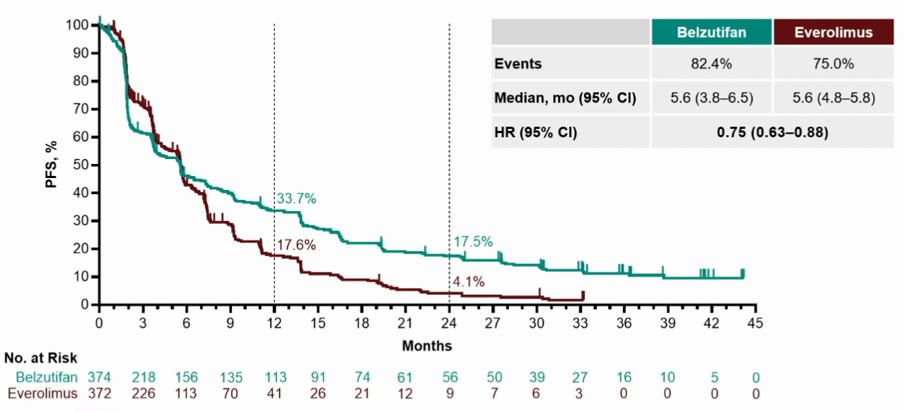
Dual primary endpoint: PFS per RECIST 1.1 by BICR (median FU: 36 mo)
Rini BI. ESMO 2024, abs.LBA74 (data from oral presentation included) Permission for use granted by the presenter
Notes:
Comments experts
High rate of censoring in everolimus arm at 6 mo.

Slide 25
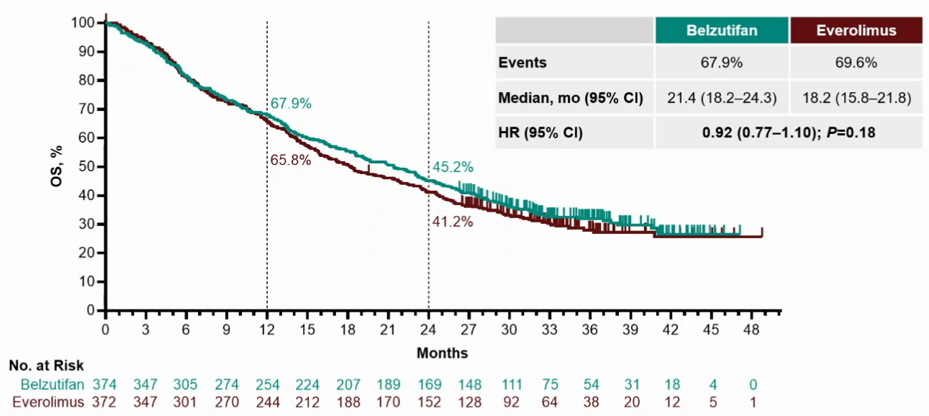
Dual primary endpoint: OS - no significant benefit (median FU: 36 mo)
Rini BI. ESMO 2024, abs.LBA74 (data from oral presentation included) Permission for use granted by the presenter

Slide 26
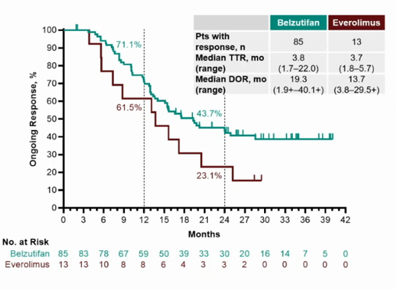
ORR and DOR per RECIST 1.1 by BICR (median FU: 36 mo)
Response (%)
 | Belzutifan (N=374) | Everolimus (N=372)
ORR (%) | 23 | 4
TTR: time to tx response
NA (Belzutifan)=5
NA (Everolimus)=9
Rini BI. ESMO 2024, abs.LBA74 (data from oral presentation included) Permission for use granted by the presenter

Slide 27
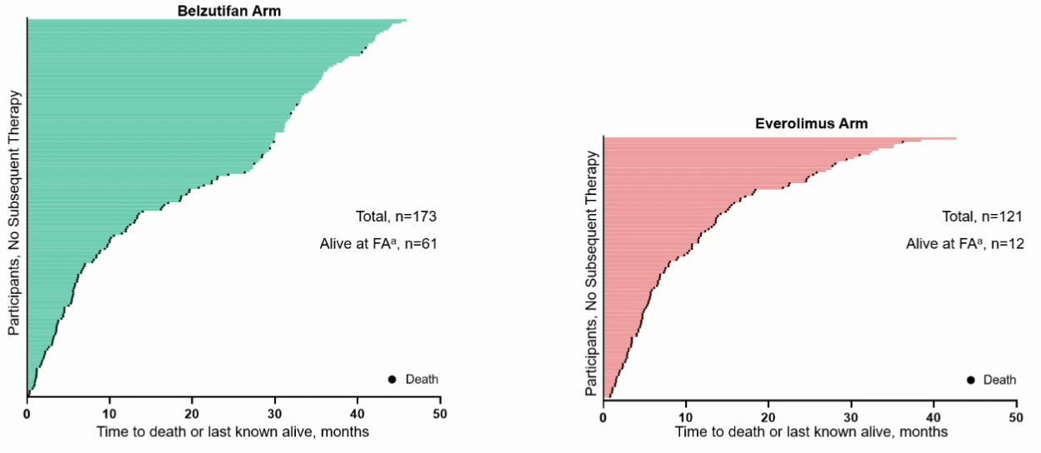
Survival FU in pts with no subsequent tx: more pts remained on belzutifan vs everolimus (median FU: 36 mo)
FA: final analysis
Pts received subsequent tx:
201/374 (53.7%) pts in belzutifan arm
251/372 (67.5%) pts in everolimus arm
Rini BI. ESMO 2024, abs.LBA74 (data from oral presentation included) Permission for use granted by the presenter

Slide 28
No new safety signals with belzutifan
 | Belzutifan N=372 | Everolimus N=360
Median duration of tx (mo) | 8 | 4
All-cause AEs (%) Grade ≥3 Serious Led to discontinuation Led to death | 99 63 43 6 4 | 99 63 39 15 5
Treatment-related AEs (%) Grade ≥3 Serious Led to death | 90 40 13 <1 | 89 40 13 <1
Rini BI. ESMO 2024, abs.LBA74 (data from oral presentation included)
Notes:
Comments experts
TRAE deaths: multiple organ dysfunction syndrome (n=1) in the belzutifan arm; sepsis (n=1) and acute kidney injury (n=1) in the everolimus arm.

Slide 29
Most common adverse drug reactions (ADR) to belzutifan
ADR | Incidence (%) | Time to 1st onset (mo) | Duration (mo)
Anaemia | 83 | 1.0 | 4.6
Hypoxia | 14 | 1.0 | 0.5
Dizziness | 13 | 2.3 | 1.1
Dyspnoea | 15 | 1.9 | 3.3
Fatigue | 32 | 1.5 | NR
Nausea | 19 | 1.4 | 1.2
Increased weight | 6 | 3.3 | 16.6
NR: not reported
Rini BI. ESMO 2024, abs.LBA74 (data from oral presentation included)

Slide 30
Is belzutifan showing sustained clinical benefits at final analysis in pretreated patients with advanced RCC?
Belzutifan continued to show PFS and ORR benefits vs everolimus, but does not improve OS.
Final analysis supports belzutifan as a tx option in pretreated pts with advanced RCC.
Notes:
Comments experts
Discussant Manuela Schmidinger pointed out that LITESPARK-005 is the only trial in which almost half (45.2%) of the pts were in a 4th-line setting. Drugs/strategies which demonstrated higher ORR or longer PFS had either less-pretreated pts or were combinations. The challenge in this study was not the comparator, but the disease stage. In this stage intratumour heterogeneity, accumulation of genetic alterations and adaptive resistance of the tumour are more present, and a significant OS benefit might have been an idealised expectation.
Belzutifan is the only targeted agent which can be used at a full dose in combination with TKI; belzutifan combinations may drive the next breakthrough in RCC.

Slide 31
Prospective randomised phase II trial of ipilimumab/nivolumab vs standard of care in non-clear-cell renal cell cancer: results of the SUNNIFORECAST trial
Bergmann L. Ann Oncol 2024;35(Suppl 2):1-72(abs.LBA75)
Notes:
Background
Non-clear cell renal cell cancers (nccRCC) are a rare and heterogeneous group of more than 20 histological and molecular defined entities. The rarity of these entities contributed to the dearth of large randomized trials and uncertainties for optimal treatment recommendations. Here, we report the final results of the prospective randomised European trial SUNNIFORECAST in therapy-naïve patients with advanced nccRCC.
Material & methods
We randomly assigned patients (pts) with nccRCC in a 1:1 ratio to receive either nivolumab 3 mg/kg IV combined with ipilimumab 1 mg/kg IV every 3 weeks for 4 doses followed by a flat dose of 240 mg IV every 2 weeks or 480 mg every 4 weeks versus SOC by investigators choice until disease progression or intolerance occurred. Pts were stratified in papillary vs. non-papillary nccRCC and according to the IMDC risk score. Central pathology was mandatory to confirm the diagnosis and nccRCC subtype according to the WHO classification 2022. The primary endpoint was OS rate at 12 mos.
Results
A total of 316 pts were screened in 7 European countries and 31 centers. The randomized population of 309 pts (70.9% male, 29.1% female) - randomized to receive either nivolumab plus ipilimumab (157 pts) or SOC (152 pts; 124 x TKI, 17 x TKI/IO, 2x others, 9 pts did not receive any study medication). 178 pts (57.6%) had papillary, 60 pts (19.4%) a chromophobe, 12 pts (3.9%) a MIT, 9 (2.9%) a collecting duct carcinoma and 50 had other subtypes. According to the IMDC score, 23.9% were of low, 51.8% of intermediate and 24.3% of high risk. The 12 mos OS rate for the entire population was 82.5%. The 12 mos OS rate for Nivo/Ipi 86.9% (95%-CI 80.2%-91.5%) was statistically significant superior to the SOC 76.8% (95%-CI 68.6%-83.1%) (p=0.014). Median OS was 42.4 mos for the Ipi/Nivo arm and 33.9 mos for the SOC arm. The ORR of 25.4% [ 95%-CI 15.8, 37.1] vs. 23.3% [ 15.1, 33.4]) and the median PFS of 5.09 [2.91–6.05] mos vs 5.55 [5.29–7.21) mos was not statistically significant different between Nivo/Ipi and SOC.
Conclusions
OS rate at 12 mos was significantly higher with nivolumab plus ipilimumab than with SOC in nccRCC pts. Additionally, pts in the Nivo/Ipi arm had a longer median OS, especially in the papillary high-risk group. Clinical trial identification: EudraCT 2016-000706-12; NCT03075423.

Slide 32
Is NIVO+IPI efficient in metastatic non-ccRCC?
Non-ccRCC is a rare and heterogenous group of >20 histologically and molecularly different cancers
The ESMO guidelines recommend CABO as preferred 1st line option for pts with papillary metastatic RCC; NIVO+IPI is one of the options for pts with metastatic non-ccRCC, non-papillary RCC and predominantly sarcomatoid RCC
Notes:
Comments experts
Data supporting the role of NIVO+IPI in pts with metastatic non-ccRCC, non-papillary RCC and predominantly sarcomatoid RCC are scarce.

Slide 33
SUNNIFORECAST: investigator-driven, multinational, phase II trial
Population
Design
Endpoints
Locally advanced or metastatic non-ccRCC (>50% non-cc component)
No prior systemic tx for RCC
KPS ≥70%
Tumour sample available
Measurable disease (RECIST v1.1)
No active CNS mets
NIVO (3 mg/kg iv)
+ IPI (1 mg/kg iv, q3w 4x)
Primary
OS rate at 12 mo
Key secondary
OS
OS rate at 6 and 18 mo
PFS
ORR
TTP
Safety
QoL
R
1:1
NIVO maintenance
(240 mg flat iv q2w or
480 mg flat IV q4w)
N=306
(planned)
SOC*
Stratification factors: Histology (papillary vs non-papillary), IMDC risk score
TTP: time to progression
*N=143 pts received SOC: 124 TKI; 17 ICI+TKI; 2 Other
Bergmann L. ESMO 2024, abs.LBA75 (data from oral presentation included)
Notes:
Comments experts
Clinicaltrials.gov identifier: NCT03075423; EudraCT 2016-000706-12.
Trial was designed to show superiority of NIVO+IPI over SOC.
Tx was continued until progression, unacceptable toxicity, or withdrawal of consent (pts may be treated beyond progression under protocol-defined circumstances).
Study was not blinded.

Slide 34
Baseline characteristics
 | NIVO+IPI (N=157) | SOC (N=152)
Median age (yr) | 61 | 64
Male (%) | 71 | 70
KPS ≥90 (%) | 73 | 82
IMDC risk group (%) Favourable / Intermediate / Poor | 25 / 50 / 25 | 23 / 53 / 24
Prior tx (%) Any surgery (Partial) Nephrectomy Any radiotherapy | 79 69 9 | 74 68 10
Time since initial diagnosis (mo) | 34 | 25
Mets sites (%) Lung / Liver / Bone / LN | 24 / 8 / 5 / 31 | 20 / 12 / 5 / 30
Bergmann L. ESMO 2024, abs.LBA75 (data from oral presentation included)

Slide 35
Histological subtypes
Subtypes of non-ccRCC (%) (central pathological review) | NIVO+IPI (N=157) | SOC (N=152) | P-value
Papillary | 57 | 59 | 0.17
Chromophobe | 18 | 21
Renal medullary carcinoma | 0 | 2
Translocation RCC | 8 | 3
Tubulocystic RCC | 2 | 0
Mucinous tubular and spindle cell carcinoma | 1 | 0
Sarcomatoid | 5 | 4
Ductus Bellini carcinoma | 0 | 2
Others | 7 | 7
Bergmann L. ESMO 2024, abs.LBA75 (data from oral presentation included)

Slide 36
OS and OS rate were in favour of NIVO+IPI vs SOC (median FU: 24 mo)
Bergmann L. ESMO 2024, abs.LBA75 (data from oral presentation included)
Notes:
Comments experts
Primary endpoint OS rate at 12 mo was met.

Slide 37
Better OS in pts with tumours expressing PD-L1, with LN mets or chromophobe RCC (median FU: 24 mo)
 | NIVO+IPI deaths/pts | SOC deaths/pts | HR (95% CI) | P-value
Baseline PD-L1 CPS <1 ≥1 NR | 33 / 71 26 / 73 7 / 13 | 19 / 58 32 / 76 11 / 18 | 1.40 (0.79-2.46) 0.56 (0.33-0.95) 1.07 (0.41-2.81) | 0.244 0.031 0.884
LN mets Yes No | 38 / 100 28 / 57 | 37 / 82 25 / 70 | 0.62 (0.39-0.98) 1.26 (0.73-2.16)
Chromophobe RCC Yes No | 10 / 28 56 / 129 | 13 / 32 49 / 120 | 0.59 (0.26-1.34) 0.89 (0.61-1.31)
Histology Papillary Non-papillary | 49 / 99 17 / 58 | 39 / 91 23 / 60 | 0.95 (0.62-1.44) 0.61 (0.33-1.15)
CPS: combined positive score
NR: not reported
Bergmann L. ESMO 2024, abs.LBA75 (data from oral presentation included)
Notes:
Comments experts
Discussant Manuela Schmidinger noted a disbalance in the PDL-1 expression between NIVO+IPI and SOC arm (higher in the SOC arm). This might have caused underperformance of SOC, since it is reported previously that PD-L1 expression in ccRCC is associated with poor outcomes after TKI tx.

Slide 38
No PFS benefit with NIVO+IPI vs SOC (median FU: 24 mo)
 | NIVO+IPI (N=157) | SOC (N=152)
Median PFS (mo) HR (95% CI) | 5.52 | 5.65
 | 0.99 (0.76-1.18)
Bergmann L. ESMO 2024, abs.LBA75 (data from oral presentation included)

Slide 39
Overall response (median FU: 24 mo)
% | All non-ccRCC (N=247*) |  | Papillary (N=148) |  | Non-papillary (N=97) |  | Chromophobe (N=54)
 | NIVO+IPI | SOC | NIVO+IPI | SOC | NIVO+IPI | SOC | NIVO+IPI | SOC
ORR CR PR SD PD | 33 8 25 33 34 | 20 2 18 62 19 | 29 10 19 38 33 | 21 3 18 61 18 | 38 6 32 18 27 | 18 0 18 61 21 | 26 0 26 44 30 | 11 0 11 78 15
*57 pts NE
P=0.001
Bergmann L. ESMO 2024, abs.LBA75 (data from oral presentation included)
Notes:
Comments experts
The highest ORR benefit was reported in patients with non-papillary RCC (difference of about 20% in favour of NIVO+IPI vs SOC).

Slide 40
Subsequent tx
N (%) | NIVO+IPI (N=157) | SOC (N=152)
2nd-line NIVO CABO SUN Others | 100 (64) 5 (5) 26 (26) 50 (50) 19 (19) | 85 (56) 37 (39) 3 (3) 34 (36) 11 (25)
3rd-line NIVO CABO SUN LEN+EVE Others | 45 (29) - 16 (36) 8 (18) 8 (18) 13 (29) | 20 (13) 7 (24) 11 (38) - - 11 (38)
4th-line | 18 (12) | 14 (9)
High number of pts received CABO in 2nd- or 3rd-line (and therefore not in 1st-line). The biggest subgroup of pts had papillary disease where CABO should be a preferred 1st-line tx option.
Bergmann L. ESMO 2024, abs.LBA75 (data from oral presentation included)

Slide 41
Most frequent AEs
% | NIVO+IPI |  | SOC |  | P
 | Any grade | Grade 3/4 | Any grade | Grade 3/4
Skin reactions | 48 | 3 | 74 | 2 | <0.001
Fatigue | 43 | 4 | 64 | 8 | <0.001
Diarrhoea | 21 | 3 | 45 | 5 | <0.001
Nausea | 21 | 1 | 32 | 1 | 0.008
Mucositis | 3 | 0 | 36 | 4 | <0.001
Hypothyroidism | 13 | <1 | 22 | 0 | 0.046
Hypertension | 6 | <1 | 39 | 17 | <0.001
Dysgeusia | 4 | 0 | 29 | 0 | <0.001
Pruritus | 25 | 0 | 3 | 1 | <0.001
Anorexia | 8 | 0 | 20 | <1 | 0.002
ALT | 14 | 6 | 13 | 0 | 0.736
Bergmann L. ESMO 2024, abs.LBA75 (data from oral presentation included)

Slide 42
Is NIVO+IPI efficient in metastatic non-ccRCC?
NIVO+IPI showed significantly superior OS rate at 12 mo (P=0.014) and ORR benefit vs SOC in pts with metastatic non-ccRCC. OS was better in pts expressing PD-L1 (CPS ≥1). OS rate benefit was not maintained at 18 mo.
OS rate benefit was similar in papillary and non-papillary RCC.
Notes:
Comments experts
SUNNIFORECAST is the 1st randomised phase II trial comparing dual ICI tx with SOC in pts with non-ccRCC.
Discussant Manuela Schmidinger pointed out that the OS rate benefit was not maintained at 18 mo (in contrast to ccRCC).
The study suffers from double heterogeneity: mix of histologies and mix of tx in the comparator arm.

Slide 43
Subcutaneous nivolumab vs intravenous nivolumab in patients with previously treated advanced or metastatic clear cell renal cell carcinoma: updated efficacy and safety results from CheckMate 67T
Albiges L. Ann Oncol 2024;35(Suppl 2):1-72(abs.1691P)
Notes:
Background
CheckMate 67T (NCT04810078) is a multicenter, randomized, open-label, phase 3 trial of subcutaneous nivolumab (NIVO SC) vs intravenous nivolumab (NIVO IV) in previously treated patients (pts) with advanced/metastatic clear-cell renal cell carcinoma (ccRCC). In the primary data analysis (min. 8 months follow-up), NIVO SC demonstrated noninferiority of the co-primary pharmacokinetic endpoints and key powered secondary efficacy endpoint (objective response rate [ORR] by blinded independent central review [BICR]) vs NIVO IV (ASCO GU 2024). Safety outcomes and health-related quality of life (ASCO 2024) were consistent between NIVO SC and NIVO IV. We report updated efficacy, safety, and immunogenicity data after a min. 15 month follow-up.
Material & methods
Pts were randomized 1:1 to receive NIVO SC 1200 mg + recombinant human hyaluronidase PH20 Q4W or NIVO IV 3 mg/kg Q2W until disease progression, unacceptable toxicity, withdrawal of consent, completion of 2 years’ treatment, or death. ORR by BICR was a key powered secondary endpoint. Other secondary objectives included safety, efficacy, and immunogenicity outcomes.
Results
A total of 495 pts were randomized to NIVO SC (n = 248) or NIVO IV (n = 247). With longer follow-up, additional responses were observed leading to an increased ORR in both arms (table). Safety reported with NIVO SC was similar or numerically lower than NIVO IV across safety categories. Study drug toxicity led to 3/2 deaths with NIVO SC/IV, which includes one additional death in the IV arm since the primary analysis. Updated anti-NIVO antibody (ANA) analyses with longer follow-up are shown in the table.
Conclusions
Efficacy and safety profiles of NIVO SC in this analysis are comparable to those of NIVO IV, consistent with the primary analysis. Immunogenicity data were consistent with the primary analysis. These updated results continue to support NIVO SC as a new option to improve pt experience and healthcare efficiency. Clinical trial identification: NCT04810078.

Slide 44
Are outcomes of sc and iv NIVO tx similar in pts with advanced or metastatic ccRCC after extended FU (min 15 mo)?
Compared with intravenous (iv) infusions, subcutaneous (sc) administration of drugs is time and resource efficient and is typically preferred by pts
Prior analysis of CheckMate 67T (min 8 mo FU) showed that sc injection of NIVO was non-inferior to iv delivery regarding blood concentrations of NIVO and ORR
Notes:
Comments experts
Previous results:
NIVO sc showed similar blood concentrations and ORR vs NIVO iv: George S. J Clin Oncol 2024;42(suppl 4):abs.LBA360 [https://ascopubs.org/doi/10.1200/JCO.2024.42.4_suppl.LBA360]
Safety outcomes and HRQoL were consistent between NIVO sc and NIVO iv: Bourlon MT et al. J Clin Oncol 2024;42(suppl 16):abs.4532 [https://ascopubs.org/doi/10.1200/JCO.2024.42.16_suppl.4532] and George S et al. J Clin Oncol 2024;42(suppl 16):abs.4535 [https://ascopubs.org/doi/10.1200/JCO.2024.42.16_suppl.4535]
First database lock: 21 August 2023 (min 8 mo FU)
Second database lock: 18 March 2024 (min 15 mo FU)

Slide 45
CheckMate 67T: open-label, multi-centre phase III trial
Population
Design
Endpoints
Locally advanced or metastatic ccRCC
Progressed during or after 1-2 prior systemic tx
No prior immunotx
KPS ≥70
NIVO sc + rHuPH20
1200 mg q4w
(N=248)
Co-primary
C(avgd28): average serum concentration over 28 days
C(minss): minimum serum concentration at steady state
Key secondary
ORR by BICR
Secondary
ORR, DCR, TTR, PFS by BICR
OS
Safety measures
Immunogenicity
R
1:1
NIVO iv
3 mg/kg q2w
(N=247)
N=495
rHuPH20: recombinant human hyaluronidase PH20
TTR: time to response
Current analysis: updated efficacy and safety data after extended FU of min 15 mo
Albiges L. ESMO 2024, abs.1691P (data from poster presentation included)
Notes:
Comments experts
Clinicaltrials.gov identifier: NCT04810078.
73 sites in 17 countries.
Secondary database lock: 18 March 2024.
Tx until disease progression, unacceptable toxicity, withdrawal of consent, completion of 2 yr tx, or death
Co-primary non-inferiority endpoints of exposure (time-averaged serum concentration over the first 28 days and trough serum concentration at steady state) and efficacy (ORR by BICR) were met. Safety was comparable in the SC vs IV arms. NIVO-related immunogenicity was as expected for SC administration.

Slide 46
Baseline characteristics
 | NIVO sc + rHuPH20 (N=248) | NIVO iv (N=247)
Median age (yr) | 64 | 66
Hispanic or Latino (%) | 38 | 34
Prior lines of tx (%) 1 / 2 | 89 / 11 | 95 / 5
KPS (%) 100 / 90 / 80 / 70 | 41 / 32 / 21 / 7 | 37 / 36 / 20 / 8
IMDC risk group (%) Favourable Intermediate Poor | 19 64 17 | 23 60 17
Prior nephrectomy (%) | 82 | 83
Central nervous system mets (%) | 14 | 9
Albiges L. ESMO 2024, abs.1691P (data from poster presentation included)

Slide 47
Efficacy summary (min FU: 15 mo)
 | NIVO sc + rHuPH20 (N=248) | NIVO iv (N=247)
BOR (%) CR PR SD PD | 2 25 36 25 | 3 18 42 27
ORR (%) | 27 | 21
Risk ratio (95% CI) | 1.28 (0.93-1.77)
DCR (%) | 63 | 63
Risk ratio (95% CI) | 1.00 (0.88-1.15)
Median TTR (mo) | 4 | 4
6-mo OS rate (%) | 84 | 86
12-mo OS rate (%) | 72 | 73
Albiges L. ESMO 2024, abs.1691P (data from poster presentation included)

Slide 48
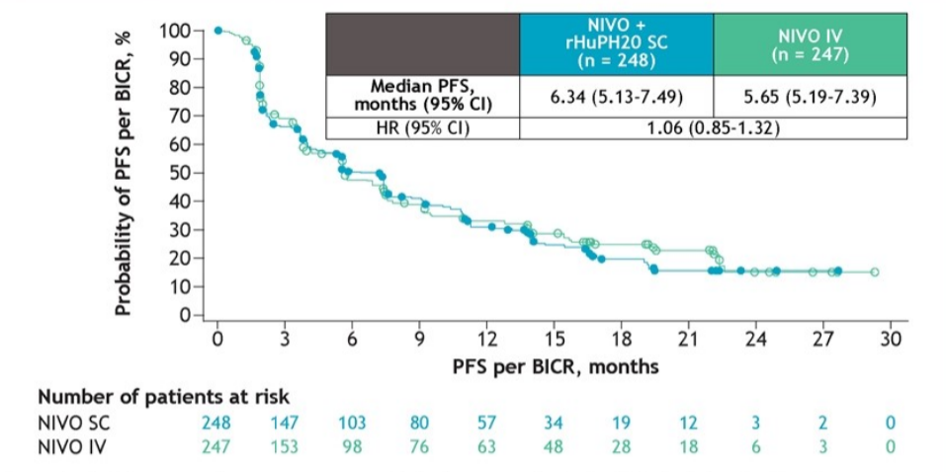
PFS by BICR (min FU: 15 mo)
Albiges L. ESMO 2024, abs.1691P (data from poster presentation included) Permission for use granted by the presenter

Slide 49
No new safety concerns with sc NIVO
% | NIVO sc + rHuPH20 (N=247) |  | NIVO iv (N=245)
 | Any grade | Grade 3/4 | Any grade | Grade 3/4
AEs | 93 | 40 | 94 | 47
TRAEs | 62 | 12 | 66 | 17
Discontinuation due to TRAEs | 5 | 3 | 5 | 4
Local site reaction TRAEs in ≥2 pts | 7 | 0 | 2 | 0
Pts who received immune-modulatory meds Pts who received corticosteroids* | 72 33 | 92 50 | 71 49 | 94 81
Selected TRAEs Skin Endocrine Hepatic Gastrointestinal Pulmonary Renal Hypersensitivity/infusion reaction | 24 13 9 6 5 3 <1 | 2 1 3 0 2 <1 <1 | 27 18 13 7 3 6 3 | 1 1 4 <1 1 0 0
*≥40 mg prednisone or equivalent
Albiges L. ESMO 2024, abs.1691P (data from poster presentation included)
Notes:
Comments experts
Data about pts who received immune-modulatory medication are from the primary database lock (21 August 2023) with min FU 8 mo for pts who experienced ≥1 irAE.
The incidence of anti-NIVO antibodies in the NIVO sc arm was within historical rates seen across NIVO iv monotx studies and had no apparent clinically meaningful impact on pharmacokinetics, efficacy and safety.

Slide 50
Are outcomes of sc and iv NIVO tx similar in pts with advanced or metastatic ccRCC after extended FU (min 15 mo)?
Updated efficacy, safety and immunogenicity data were similar between sc and iv NIVO arm. These data continue to support NIVO sc as an option which may improve healthcare efficiency and pt tx experience.

Slide 51
CaboPoint: final results from a phase II study of cabozantinib after checkpoint inhibitor combinations in patients with advanced renal cell carcinoma
Albiges L. Ann Oncol 2024;35(Suppl 2):1-72(abs.1693P)
Notes:
Background
We report final data from CaboPoint, a prospective study of second-line (2L) cabozantinib in advanced renal cell carcinoma (aRCC) after first-line (1L) standard of care checkpoint inhibitor (CPI)-based therapy.
Material & methods
CaboPoint (NCT03945773) is a multicenter, open-label trial in adults with locally advanced, or metastatic clear cell RCC with progression on 1L CPI-based therapy. Patients (pts) started 2L cabozantinib at 60 mg/day after 1L nivolumab + ipilimumab (cohort A) and 1L CPI + VEGF-targeted therapy (cohort B). Primary endpoint: objective response rate (ORR) by independent review committee (IRC) in cohort A (per RECIST 1.1). Secondary endpoints: ORR by IRC in cohort B, ORR by investigator review (IR), disease control rate (DCR), progression-free survival (PFS), overall survival (OS) and safety.
Results
127 pts were included (cohort: A, 85; B, 42) and median follow-up was 19.3 months. Baseline characteristics were similar in cohorts A and B: mean age, 63.2 and 66.2 years; male, 74% and 79%; IMDC risk, favourable, 4% and 18%, intermediate, 47% and 39%, poor, 12% and 13%, unknown, 38% and 31%. Efficacy results are in the table. In cohorts A and B: common (>10% of pts) grade 3/4 treatment-emergent adverse events (TEAEs) were hypertension (38% and 21%) and diarrhoea (12% and 10%); TEAEs led to treatment interruption in 88% and 76% of pts and discontinuation in 19% and 19%; treatment-related serious TEAEs occurred in 29% and 17%.
Conclusions
2L cabozantinib was effective in aRCC pts in the post-CPI combination setting and had no new safety signals. Clinical trial identification: NCT03945773.

Slide 52
Is 2nd-line CABO effective in pts who progressed on ICI combination tx?
ICI-based combination tx is the 1st-line SOC for advanced RCC
CABO showed preliminary efficacy as 2nd-line tx after progression on ICI-based combinations (interim analysis of CaboPoint trial, min FU of 3 mo)
Notes:
Comments experts
Interim analysis: Albiges L et al. J Clin Oncolo 2023;41(suppl 6):606 [https://meetings.asco.org/abstracts-presentations/217382].

Slide 53
CaboPoint: multi-centre, open-label prospective phase II trial (Jan 2020-Nov 2023)
Population
Design
Endpoints
Histologically confirmed unresectable advanced or metastatic RCC
Clear-cell component
Radiographic progression on ICI-ICI or ICI-TKI tx
No prior CABO
No untreated brain or leptomeningeal mets
Primary endpoint
ORR (RECIST v1.1) in cohort A, by ICR
Key secondary endpoints
ORR in cohort B, by ICR
ORR in cohort A and B, by local investigator review
PFS
OS
Safety and tolerability
Cohort A
N=85
Pts progressed on ICI+ICI
Cohort B
N=42
Pts progressed on ICI+VEGFR-TKI
CABO (60 mg qd)
ICR: independent central review
Additional secondary endpoints: DCR, TTR and DOR
Current analysis: final analysis after median FU of 19 mo
Albiges L. ESMO 2024, abs.1693P (data from poster presentation included)
Notes:
Comments experts
Clinicaltrials.gov identifier: NCT03945773.
50 centres across Austria, France, Germany, the Netherlands, Spain, Switzerland and the UK.
Rationale and study design described in Albiges L et al. Future Oncol 2022;18:915-26 [https://pubmed.ncbi.nlm.nih.gov/34911359/].

Slide 54
Selected baseline characteristics
 | Cohort A (N=85) | Cohort B (N=42) | Overall (N=127)
Median age (yr) | 63 | 66 | 64
Male (%) | 74 | 79 | 76
IMDC risk group (%) Favourable / Intermediate / Poor | 6 / 75 / 19 | 26 / 56 / 19 | 13 / 68 / 19
Prior nephrectomy (%) | 58 | 76 | 64
Mets (%) ≥3 mets sites | 68 42 | 57 36 | 64 40
Prior systemic tx for RCC (%) NIVO+IPI* AVE+AXI PEMBRO+AXI | 99 0 0 | 0 31 69 | 66 10 23
*1 pt deviated from protocol and received NIVO monotx
Albiges L. ESMO 2024, abs.1693P (data from poster presentation included)

Slide 55
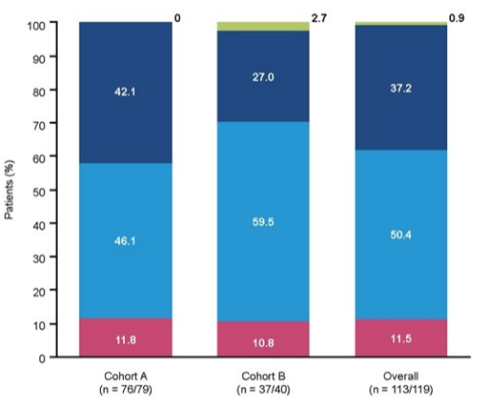
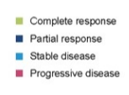
ORR and DCR by ICR (median FU: 19 mo)
% | Cohort A (N=79) | Cohort B (N=40) | Overall (N=119*)
ORR | 41 | 28 | 36
DCR | 85 | 83 | 84
P | <0.0001 | - | -
*8 pts ( from cohort A and 2 from cohort B) were excluded from the
efficacy analysis due to lacking baseline target lesions for central
tumour assessment
Albiges L. ESMO 2024, abs.1693P (data from poster presentation included) Permission for use granted by the presenter
Notes:
Comments experts
Only 1 CR was reported, in cohort B.
Post-hoc analysis of confirmed ORR (95% CI) by ICR was 34% (24-46%; 27/79 pts) in cohort A and 20% (9-36%; 8/40 pts) in cohort B.

Slide 56
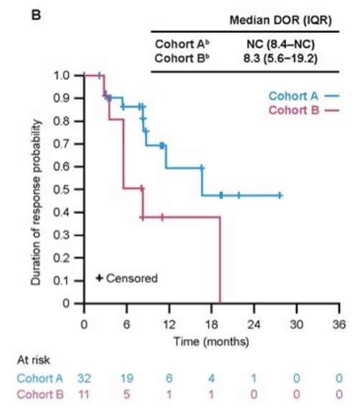
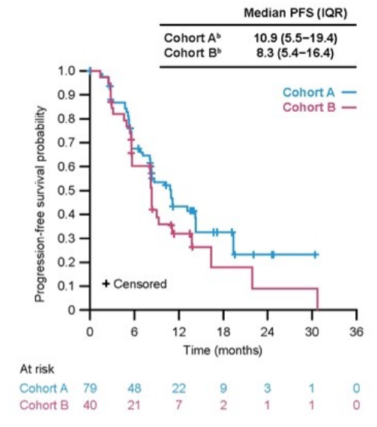
DOR and PFS by ICR (median FU: 19 mo)
IQR: interquartile range
NC: not calculable
^{b}8 pts (6 from cohort A and 2 from cohort B) were excluded from the efficacy
analysis due to lacking baseline target lesions for central tumour assessment
Albiges L. ESMO 2024, abs.1693P (data from poster presentation included) Permission for use granted by the presenter

Slide 57
Time to response by ICR and OS (median FU: 19 mo)
 | Cohort A (N=32) | Cohort B (N=11)
Median TTR (mo)* (IQR) | 2.8 (2.7-5.5) | 2.8 (2.8-2.9)
*in pts who responded in the efficacy population
Albiges L. ESMO 2024, abs.1693P (data from poster presentation included)
Notes:
Comments experts
DOR, PFS and TTR evaluated by independent reviewer were similar to ICR assessment (data not shown).

Slide 58
Treatment-emergent adverse events
 | Cohort A (N=85) | Cohort B (N=42)
Grade 3/4 TEAE in ≥10% of pts (%) Hypertension Diarrhoea | 38 12 | 21 10
TEAE leading to tx interruption (%) | 79 | 76
TEAE leading to dose reduction (%) | 31 | 26
Serious TEAE (%) | 29 | 17
Albiges L. ESMO 2024, abs.1693P (data from poster presentation included)

Slide 59
Is 2nd-line CABO effective in pts who progressed on ICI combination tx?
In this non-randomised study, 2nd-line CABO was well-tolerated and effective in pts with advanced RCC who progress on 1st-line ICI+ICI or ICI+VEGFR-TKI combination tx, with higher PFS and ORR after ICI+ICI in the 1st-line.

Slide 60
Updated overall survival in patients with prior checkpoint inhibitor therapy in the phase III TIVO-3 study
Zugman M. Ann Oncol 2024;35(Suppl 2):1-72(abs.1703P)
Notes:
Background
The phase III TIVO-3 study demonstrated improvement in progression-free survival (PFS) with tivozanib compared to sorafenib in patients with 2-3 prior systemic therapies for metastatic renal cell carcinoma (mRCC). In the present analysis, we updated outcomes of patients with prior checkpoint inhibitor (CPI) exposure in the TIVO-3 study.
Material & methods
The TIVO-3 trial enrolled patients with measurable mRCC who had received 2-3 prior systemic therapies, including a vascular endothelial growth factor tyrosine kinase inhibitor (VEGF-TKI). Patients were stratified by International Metastatic RCC Database Consortium (IMDC) risk score and type of prior treatment and were randomized 1:1 to receive tivozanib or sorafenib. Efficacy was assessed using RECIST 1.1 criteria, with PFS as the primary endpoint. Safety was evaluated using CTCAE v4.03, and statistical analyses included Cox regression for overall survival (OS) and descriptive statistics for duration of response (DOR). Central to the current post-hoc analysis was assessment of OS in the previously stratified subpopulation of patients with prior CPI exposure.
Results
Between May 2016, and August 2017, 350 patients were randomized, of which 26% had prior CPI exposure, with final analysis data cut off on June 21, 2021. In patients previously treated with CPIs, the median PFS of tivozanib was 7.3 months versus 5.1 months with sorafenib, hazard ratio (HR) of 0·55 (95% CI 0·32–0·94). The OS HR in the CPI-treated subset was 0.67 (95%CI: 0.42-1.08). Tivozanib also demonstrated a longer median DOR of 20.3 months versus 5.7 months in the subset previously treated with CPIs. The safety profile favored tivozanib, with lower rates of VEGF-TKI class related grade ≥3 adverse events compared to sorafenib. However, in the subset of patients previously treated with CPIs, the incidence of grade ≥3 adverse events was higher, at 58% for tivozanib and 67% for sorafenib, compared to 41% and 51%, respectively, in those without prior CPI therapy.
Conclusions
In this updated analysis of the TIVO-3 trial, we show that in CPI-refractory mRCC, the PFS benefit of tivozanib over sorafenib is accompanied with a trend towards improved OS and durable responses. These data underscore tivozanib's value as a treatment option in CPI-refractory mRCC. Clinical trial identification: NCT02627963.

Slide 61
Is TIVO effective in pts who progressed after prior ICI tx?
TIVO is a VEGFR-TKI approved for pts with relapsed or refractory advanced RCC following ≥2 lines of systemic tx
TIVO demonstrated significant activity in pts previously treated with VEGFR-TKIs
Notes:
Comments experts
TIVO activity in pts previously treated with sorafenib: Rini BI et al. Lancet Oncol 2020;21:95-104 [https://pubmed.ncbi.nlm.nih.gov/31810797/].
TIVO activity in pts previously treated with axitinib: Meza L et al. Oncologist 2023;28:e167-e170 [https://pubmed.ncbi.nlm.nih.gov/36576430/].
Previous long-term PFS data indicate that pts without disease progression at 12 mo often derive substantial, durable benefits from TIVO.

Slide 62
TIVO-3: a multi-centre, open-label, phase III study (May 2016-Aug 2017)
Population
Design
Endpoints
Recurrent/relapsed metastatic ccRCC
Failure of ≥2 prior regimens including ≥1 VEGFR-TKI
ECOG PS 0-1
TIVO 1.34 mg po qd
(3 wk on, 1 wk off per cycle)
Primary
PFS
Secondary
OS
ORR
DOR
Safety
R
1:1
Sorafenib 400 mg po bid
(continuously in 4-wk cycles)
N=350
Stratification factors: Prior regimen (TKI-ICI, TKI-TKI, TKI-other), IMDC prognostic score
Current analysis: post-hoc, long-term FU analysis of OS and DOR in subgroup of pts with prior ICI exposure (26% of pts)
Zugman M. ESMO 2024, abs.1703P (data from poster presentation included)
Notes:
Comments experts
Clinicaltrials.gov identifier: NCT02627963.
Data cut-off: 21 June 2021.

Slide 63
Baseline characteristics of pts with prior ICI exposure
 | TIVO (N=47) | Sorafenib (N=44)
Median age (yr) | 62 | 67
Male (%) | 72 | 77
IMDC risk category (%) Favourable Intermediate Poor | 26 64 11 | 27 64 9
Clear cell histopathology (%) | 94 | 86
Previous lines of tx (%) 2 3 | 53 47 | 45 55
Previous TKI+ICI tx (%) | 100 | 100
Zugman M. ESMO 2024, abs.1703P (data from poster presentation included)

Slide 64
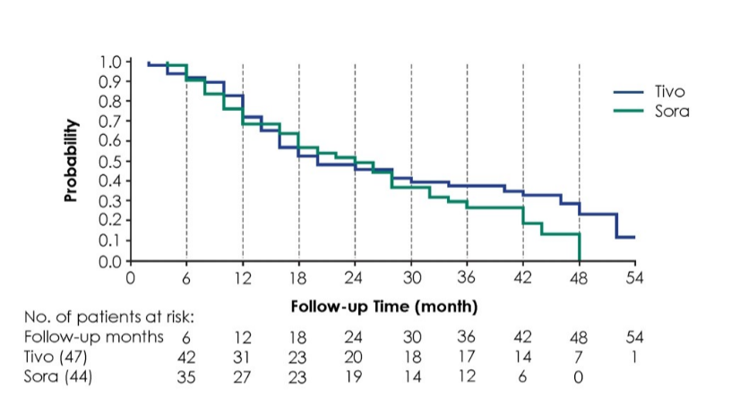
OS in pts with previous ICI exposure
 | TIVO (N=47) | SORA (N=44)
Median OS (mo) | 18.1 | 20.9
Zugman M. ESMO 2024, abs.1703P (data from poster presentation included) Permission for use granted by the presenter

Slide 65
Efficacy in pts with previous ICI exposure
 | TIVO |  | Sorafenib
 | ITT (N=175) | Prior ICI (N=47) | ITT (N=175) | Prior ICI (N=44)
Median PFS (mo) HR (95% CI), P | 5.6 0.73 (0.56-0.95), 0.02 | 7.3 0.55 (0.32-0.94) | 3.9 | 5.1
1-yr PFS rate (%) | 28 | 37 | 11 | 5
Median OS (mo) HR (95% CI), P | 16.4 0.89 (0.70-1.14), 0.35 | 18.1 0.69 (0.43-1.11) | 19.2 | 20.9
ORR (%) | 18 | 24 | 8 | 7
Median DOR (mo) | 22.0 | 20.3 | 5.7 | 5.7
TTR (mo) | 3.6 | 2.0 | - | -
Disease progression (%) | 22 | 18 | - | -
Zugman M. ESMO 2024, abs.1703P (data from poster presentation included)
Notes:
Comments experts
The safety profile favoured TIVO, with lower rates of grade ≥3 AEs compared to sorafenib. However, in the subset of pts previously treated with ICIs, the incidence of grade ≥3 AEs was higher (58% for TIVO and 67% for sorafenib) compared to pts without prior ICI tx (41% for TIVO and 51% for sorafenib).

Slide 66
Is TIVO effective in pts who progressed after prior ICI tx?
TIVO had a median PFS benefit vs sorafenib (7.3 mo vs 5.1 mo) in pts refractory to ICI tx and trended towards improved OS and durable responses.

Slide 67
Impact of sarcomatoid and rhabdoid components on the efficacy of nivolumab +/- ipilimumab in the first-line treatment of metastatic clear cell renal cell carcinoma in the randomised phase II BIONIKK trial
Vano YA. Ann Oncol 2024;35(Suppl 2):1-72(abs.1700P)
Notes:
Background
The BIONIKK trial showed promising efficacy of N+/-I and TKI in the first-line (L1) metastatic renal cell carcinoma (mRCC) according to tumor molecular group. Sarcomatoid (S)/rhabdoid (R) components (comp.) are associated with poor prognosis but conversely may predict the efficacy of immune checkpoint inhibitors. We report on the impact of S/R on the efficacy of L1 in the BIONIKK trial.
Material & methods
Patients (pts) with mRCC were randomized according to ccrcc1-4 molecular group to receive nivolumab (N) (58), nivolumab/ipilimumab (NI) (101) or TKI (40) in L1. Centralized pathological review was performed to identify ISUP grade, to quantify S/R comp. and the immune infiltrate (scale 0 to 3). Endpoints were objective response rate (ORR), progression-free survival (PFS) and overall survival (OS) according to S/R. Median follow-up was 46.6 months (IQR: 41.2-54.4).
Results
Of the 199 pts included, S, R and S+R was found in 23 (27.6%), 23 and 32 (co-presence: 58%) tumors respectively. Compared to pts with non-S/R tumors, those with S/R are more often IMDC int+poor (82%/78% vs 63%), have their tumors enriched in ccrcc1+4 (78%/69% vs 50%) and more immune infiltrates (2+3 in 87% vs 57%). Compared with pts without S, S-mRCC pts treated with N tended to have a higher rate of progressive disease (50% vs 34%), a shorter PFS (HR 1.23 [95%CI 0.68-2.22]), and a shorter OS (HR 2.56 [95%CI 1.28-5]), as did pts treated with TKI. Conversely, S-mRCC pts treated with NI had a higher ORR (68% vs. 42%), a longer PFS (HR 0.73 [95%CI 0.43-1.23]), and a similar OS (HR 1.03 [95%CI 0.52-2.04]). Compared with ISUP 4 tumors without S/R, S/R were associated with shorter PFS and OS with N or with TKI, and a higher ORR, PFS and OS with NI (table).
Conclusions
Within the BIONIKK study, we confirm the high co-occurrence of S and R comp. in mRCC, as well as a poor prognosis associated with the S comp. We also confirmed the particular efficacy of NI, but not N alone in S-mRCC. Results by ccrcc group, R comp. and %S/R will be presented. Clinical trial identification: NCT02960906.

Slide 68
Are RCC tumours with sarcomatoid (S) and rhabdoid (R) component responsive to 1st-line NIVO±IPI?
RCC tumours with S and R components are strongly associated with poor prognosis
1st-line NIVO±IPI showed promising efficacy in certain tumour molecular groups of metastatic RCC
Notes:
Comments experts
Vano YA et al. Lancet Oncol 2022;23:e318 [https://pubmed.ncbi.nlm.nih.gov/35772460/].

Slide 69
BIONIKK: French, multicentre, randomised phase II trial
Population
Design
Metastatic ccRCC
Systemic tx-naïve
ECOG PS 0-2
No active brain mets
Frozen tumour tissue
Molecular grouping ccrcc1-4
≤15 d from screening
NIVO 3 mg/kg iv q2w
ccrcc1,4
R
NIVO 3 mg/kg + IPI 1 mg/kg iv q3w (4 cycles followed by NIVO 240 mg q2w)
ccrcc2,3
R
VEGFR-TKI
SUN 50 mg po qd, 4 wk on/2 wk off, or PAZO 800 mg po qd
TME: tumour microenvironment
ccrcc1: immune-low TME; ccrcc4: immune-high and immunosuppressive TME
ccrcc2: angio-high TME; ccrcc3: normal-like TME
Tx until disease progression, death or end of study (18 mo)
Endpoints: ORR (RECIST v1.1), PFS and OS according to S/R
Current analysis: investigating impact of S and R components on NIVO±IPI efficacy
N= 199 pts in total; N= 55 pts with S component (28%); N= 55 pts with R component (28%)
Vano YA. ESMO 2024, abs.1700P (data from poster presentation included)
Notes:
Comments experts
Clinicaltrials.gov identifier: NCT02960906.
N= 199 pts in total.
N= 55 pts with S component (28% of 199); N= 55 pts with R component (28% of 199); N= 78 pts had S and/or R component; N=32 pts had S and R component; 32/55= 58% of pts with S component also had R component.

Slide 70
Baseline characteristics according to S/R component
 | Sarcomatoid (N=55) | Rhabdoid (N=55) | None (N=121)
Median age (yr) | 64 | 62 | 64
Male (%) | 69 | 75 | 77
IMDC risk group (%) Fav / Interm / Poor | 18 / 55 / 27 | 22 / 54 / 24 | 37 / 45 / 18
ECOG PS 1-2 (%) | 33 | 20 | 26
Prior nephrectomy (%) | 75 | 87 | 69
>2 mets sites (%) | 71 | 67 | 75
Prior systemic tx for RCC (%) NIVO / NIVO+IPI / TKI (SUN or PAZO) | 36 / 46 / 18 | 25 / 55 / 20 | 28 / 50 / 22
Molecular group (%) ccrcc1 / ccrcc2 / ccrcc3 / ccrcc4 | 47 / 18 / 4 / 31 | 51 / 29 / 2 / 18 | 38 / 45 / 6 / 11
N=32 pts had co-occurrence of S and R component; these pts are included in both groups; 32/55= 58% of pts with S component also had R component
Vano YA. ESMO 2024, abs.1700P (data from poster presentation included)
Notes:
Comments experts
Compared to pts with non-S/R tumours, those with S/R component had more often intermediate or poor IMDC risk (82%/78% vs 63%) and had tumours enriched in ccrcc1+4 (78%/69% vs 50%).

Slide 71
Response rate according to tx and presence of S component (median FU: 47 mo)
NIVO
NIVO+IPI
VEGFR-TKI
Response (%)
Response (%)
Response (%)
P=0.5
P=0.041
P=0.3
NE (S (+))=5
NE (S (-))=3
NE (S (-))=3
NE (S (+))=10
NE (S (-))=10
Vano YA. ESMO 2024, abs.1700P (data from poster presentation included)
Notes:
Comments experts
Tumours with S component had a non-significant trend for a lower ORR (CR+PR) and a higher upfront PD with NIVO or TKI.
On the contrary, S component was associated with a significantly higher ORR with NIVO+IPI (68% vs 42% in pts without S, P=0.041), irrespective of ccrcc group.

Slide 72
Outcomes according to presence of S/R component (median FU: 47 mo)
 | NIVO | NIVO+IPI | VEGFR-TKI
ORR (%) S and/or R component (N=78) ISUP 4, no S/R (N=21) ISUP ≤3, no S/R (N=100) | 29 33 39 | 62 8 48 | 50 80 48
Median PFS (mo) S and/or R component ISUP 4, no S/R HR (95% CI) | 2.4 7.7 0.78 (0.23-2.70) | 15.0 4.8 0.31 (0.16-0.62) | 9.1 35.2 3.44 (0.98-12.5)
Median OS (mo) S and/or R component ISUP 4, no S/R HR (95% CI) | 21.2 NR 4.76 (0.62-33.3) | 47.1 36.8 0.77 (0.32-1.85) | 40.5 NR 4.0 (0.50-33.3)
Vano YA. ESMO 2024, abs.1700P (data from poster presentation included)

Slide 73
Are RCC tumours with S and R component responsive to 1st-line NIVO±IPI?
NIVO+IPI (but not NIVO monotx) was particularly efficient in tumours with S/R component. Co-occurence of S and R component was present in 58% of pts.

Slide 74
Anlotinib combined with anti-PD-L1 antibody benmelstobart (TQB2450) vs sunitinib in 1st-line treatment of advanced renal cell carcinoma: a randomised, open-label, phase III study (ETER100)
Sheng X. Ann Oncol 2024;35(Suppl 2):1-72(abs.LBA76)
Notes:
Background
Benmelstobart（BMSB, TQB2450) is a humanized monoclonal antibody against PD-L1 and Anlotinib (ALTN) is an anti-angiogenic oral multi-target tyrosine kinase inhibitor. Here, we report the interim analysis results of a randomized, open label, phase 3 trial (NCT04523272) comparing BMSB plus ALTN with sunitinib as first-line treatment for advanced renal cell carcinoma (RCC) patients (pts).
Material & methods
Eligible pts had untreated unresectable or metastatic clear cell RCC and were favorable, intermediate or poor risk per IMDC criteria. Pts were randomized in a 1:1 ratio to receive BMSB (1200mg) intravenously once every 3 weeks plus ALTN (12mg) orally once daily (2-week on/1-week off) or sunitinib (50mg) orally once daily (4-week on/2-week off). The primary endpoint was progression-free survival (PFS) assessed by the blinded independent central review per RECIST version 1.1.
Results
A total of 531 pts were randomized: 266 to BMSB + ALTN, 265 to sunitinib. As of Janurary 31, 2024, BMSB + ALTN significantly improved PFS (HR 0.53 [95% CI 0.42-0.67]; P< 0.0001; median 18.96 vs 9.76 mo), and ORR (71.59% vs 25.10%; P< 0.0001) after a median follow-up of 19.52 mo.The median overall survival was not reached in both arms (HR=0.66 [95% CI: 0.48-0.92]). The BMSB + ALTN benefit was observed in all subgroups tested, including all IMDC risk and PD-L1 expression subgroups. The incidence of Grade ≥3 adverse events (AEs) (75.0% vs 74.62%), AEs leading to discontinuation of treatment (12.50% vs 6.44%), fatal AEs (4.92% vs 2.27%) were similar between two arms.
Conclusions
Benmelstobart plus Anlotinib provided superior PFS and ORR compared with sunitinib, and had manageable safety in pts with previously untreated advanced RCC. These results support the use of Benmelstobart plus anlotinib as a new first-line treatment for advanced RCC. Clinical trial identification: NCT04523272.

Slide 75
Is anlotinib + benmelstobart combination efficient as 1st-line tx in pts with advanced ccRCC?
ICI+TKI combinations are 1st-line SOC for advanced RCC
Anlotinib is an anti-angiogenic oral multi-target 3rd-generation VEGFR-TKI
Benmelstobart is a humanised monoclonal antibody against PD-L1
Notes:
Comments experts
Anlotinib: 3rd generation VEGFT-TKI (similar to AXI and TIVO), high selectivity towards VEGFR2 => less off-target TRAEs. It has an extremely long half-life of 96h – good for scheduling optimization and maintaining angiogenesis over time, but in case of AEs it is necessary to discontinue drug for a long time.
Benmelstobart: humanised anti-PD-L1 monoclonal antibody with significant sequence divergence from other anti-PD-L1 benchmark antibodies (ATEZO, Durvalumab, Avelumab) and no Fc activity. With very high K_{D} , it may be the best-in-class VEGFR-TKI.

Slide 76
ETER100: Chinese randomised, open-label, phase III study
Population
Design
Endpoints
Locally advanced or metastatic ccRCC
Age 18-80 yr
No prior systemic tx
ECOG PS 0-1
At least 1 measurable lesion per RECIST v1.1
Primary
PFS by BICR (RECIST v1.1)
Secondary
PFS by investigator
OS
ORR
DCR
DOR
Safety
Anlotinib 12 mg qd d1-14/q3w
+
Benmelstobart 1200 mg d1/q3w
(N=266)
R
1:1
Sunitinib 50 mg qd d1-28/q6w
(N=265)
Stratification factors: IMDC risk group
DCR: disease control rate
Tx until disease progression or intolerable toxicity
Sheng X. ESMO 2024, abs.LBA76 (data from oral presentation included)
Notes:
Comments experts
Clinicaltrials.gov identifier: NCT04523272.
Data cut-off: 31 January 2024.

Slide 77
Baseline characteristics
 | Anlotinib + Benmelstobart (N=264) | Sunitinib (N=263) | Total (N=527)
Median age (yr) | 61 | 59 | 60
Male (%) | 77 | 75 | 76
ECOG PS (%) 0 / 1 | 27 / 73 | 26 / 74 | 27 / 73
Prior nephrectomy (%) | 67 | 66 | 66
KPS ≥90 (%) | 77 | 81 | 79
IMDC risk group (%) Fav / Intermed / Poor | 14 / 71 / 15 | 14 / 72 / 14 | 14 / 72 /15
≥2 organs with mets (%) | 46 | 47 | 47
Site of mets (%) Lung / Bone / Liver | 63 / 22 / 13 | 61 / 21 / 10 | 62 / 21 / 12
Sheng X. ESMO 2024, abs.LBA76 (data from oral presentation included)

Slide 78
Significantly longer PFS by BICR in tx arm (median FU: 19 mo)
P<0.0001
Sheng X. ESMO 2024, abs.LBA76 (data from oral presentation included)

Slide 79
Higher ORR and immature OS data in tx arm (median FU: 19 mo)
 | Anlotinib + Benmelstobart (N=264) | Sunitinib (N=263)
CR (%) | 1 | 0
PR (%) | 71 | 25
ORR (%) P-value | 72 | 25
 | <0.001
 | Anlotinib + Benmelstobart (N=264) | Sunitinib (N=263)
Events / Total | 64 / 264 | 80 / 263
Median OS (mo) HR (95% CI), P | NE | NE
 | 0.66 (0.48-0.92), 0.067
Sheng X. ESMO 2024, abs.LBA76 (data from oral presentation included)
Notes:
Comments experts
Very low anti-tumour activity of anlotinib + benmelstobart (just 1.1% CR).

Slide 80
Safety summary
 | Anlotinib + Benmelstobart (N=264) | Sunitinib (N=264)
TEAEs (%) Grade ≥3 | 99 75 | 99 75
TRAEs (%) Grade ≥3 | 98 67 | 98 66
Serious AEs (%) | 39 | 28
irAEs (%) Grade ≥3 | 33 9 | - -
Infusion-related reaction (%) | 5 | -
irAE: immune-related AE
Sheng X. ESMO 2024, abs.LBA76 (data from oral presentation included)

Slide 81
Is anlotinib + benmelstobart combination efficient as 1st-line tx in pts with advanced ccRCC?
The addition of benmelstobart to anlotinib showed superior PFS (19 mo vs 10 mo) and ORR (72% vs 25%) compared to sunitinib.
Notes:
Comments experts
Short follow-up – early OS data; Good distribution of pts among 3 IMDC groups; PFS similar to other ICI+TKI combinations; Low CR (possibly because it is PD-L1 inhibitor).
Discussant Camillo Porta commented that
anlotinib’s selectivity and long half-life might be beneficial features
benmelstobart has structural and pharmacokinetic properties which put it atop the list of PD-L1 inhibitors
in case of global distribution and in case the price on the market would be very favourable, there might be a place for this combination.

Slide 82
Faecal microbiota transplantation vs placebo in patients receiving pembrolizumab plus axitinib for metastatic renal cell carcinoma: preliminary results of the randomised phase II TACITO trial
Ciccarese C. Ann Oncol 2024;35(Suppl 2):1-72(absLBA77)
Notes:
Background
Combinations of VEGFR-TKIs plus immune checkpoint inhibitors (ICIs) anti-PD-1 are the standard first-line therapy for patients (pts) with metastatic renal cell carcinoma (mRCC). Intestinal microbiota composition could influence ICIs activity in mRCC and other cancers, while faecal microbiota transplantation (FMT) is currently used to regulate microbiota-related diseases. TACITO trial (NCT04758507) investigated whether FMT could increase the efficacy of VEGFR-TKI+ICI combinations in mRCC.
Material & methods
mRCC pts treated with axitinib+pembrolizumab (axi+pembro) in first-line were randomized (1:1) to FMT or placebo (pbo). Pts received direct infusion in the colon of stools from a donor or pbo at baseline (within 8 weeks from the start of axi+pembro, FMT1), followed by oral capsules with the same frozen stools or pbo at 90 (FMT2), and 180 days (FMT3), respectively. The donor was a mRCC patient (pt) who achieved complete and long-lasting response to ICIs. The primary endpoint was to increase of ≥20% the rate of pts with no disease progression at one year (1-year PFS rate) with FMT vs. pbo. Secondary endpoints were median PFS, overall survival (OS), objective response rate (ORR), and microbiota characterization.
Results
50 pts were randomized to FMT (IMDC risk: 28% favorable, 72% intermediate-poor) or pbo (32% favorable, 68% intermediate-poor). 44 pts were evaluable for the primary endpoint (24 in the FMT group and 20 in the pbo). The 1-year PFS rate was 66.7% with FMT vs. 35.0% with pbo, p=0.036. In the overall population, after a median follow-up of 28.0 mos, the mPFS was 14.2 (95%CI, 0.9–27.6) vs. 9.2 (95%CI, 3.0–15.4) mos and the mOS was not reached vs. 25.3 (95%CI, 17.1–33.6) mos with FMT and pbo, respectively. The ORR was 54% vs. 28% in the FMT arm compared to pbo; 38% vs. 44% had SD and 8% vs. 28% had PD. Safety: only 1 pt in the pbo arm reported FMT/pbo-related adverse event (grade 3 oral mucositis) and discontinued capsules assumption.
Conclusions
The preliminary results of TACITO trial show for the first time the role of FMT in increasing the activity of ICIs-based therapies in mRCC pts. Clinical trial identification: NCT04758507.

Slide 83
Can FMT from a pt responding to ICI tx increase the activity of AXI+PEMBRO in tx-naïve mRCC pts?
The composition of gut microbiota influences the response to ICI tx
Faecal microbiota transplantation (FMT) can regulate microbiota-related diseases and has emerged as potential tool to overcome resistance to ICI
Notes:
Comments experts
FMT as a tool for overcoming ICI resistance:
Baruch EN et al. Science 2021;371:602-9 [https://pubmed.ncbi.nlm.nih.gov/33303685/]
Routy B et al. Nat Med 2023;29:2121-32 [https://pubmed.ncbi.nlm.nih.gov/37414899/]
Kim Y et al. Cell Host Microbe 2024;32:1380-93 [https://pubmed.ncbi.nlm.nih.gov/39059396/]
Discussant Camillo Porta noted that according to the literature, faeces from healthy volunteers seems to have better effects than faeces from pts experiencing CR or PR after ICI tx.

Slide 84
TACITO: a randomised phase II study
Population
Design
Endpoints
Any histology RCC
Measurable disease
ECOG PS 0-1
Eligible to AXI+PEMBRO
FMT
Primary
12-mo PFS rate
Secondary
PFS
OS
ORR
Safety
Microbiota characterisation
R
1:1
PBO
N=50
AXI+PEMBRO per SOC
FMT/PBO 1
8 wk after
AXI+PEMBRO start
FMT/PBO 2
12 wk after
FMT/PBO 1
FMT/PBO 3
24 wk after
FMT/PBO 1
FMT/PBO 1: transplantation by colonoscopy
FMT/PBO 2 and FMT/PBO 3: transplantation by frozen oral capsule
The donor was a pt who responded extremely well to IPI+NIVO
Ciccarese C. ESMO 2024, abs.LBA77 (data from oral presentation included)
Notes:
Comments experts
Clinicaltrials.gov identifier: NCT04758507.

Slide 85
Baseline characteristics
 | FMT (N=25) | PBO (N=25)
Median age (yr) | 61 | 61
Male (%) | 76 | 76
Previous nephrectomy (%) | 56 | 64
Tumour histology (%) Clear cell Papillary Chromophobe | 92 4 4 | 84 12 4
IMDC prognostic score (%) Favourable / Intermediate / Poor | 28 / 56 / 16 | 32 / 48 / 20
Sites of mets (%) Lung / LN / Bone/ Pancreas / Liver | 76 / 36 / 28 / 24 / 12 | 64 / 60 / 24 / 8 / 24
Ciccarese C. ESMO 2024, abs.LBA77 (data from oral presentation included)

Slide 86
Primary endpoint: 12-mo PFS rate
FMT increased the 12 mo PFS rate by 32%
compared to PBO, P=0.036
Ciccarese C. ESMO 2024, abs.LBA77 (data from oral presentation included)

Slide 87
Secondary endpoints: PFS, OS and ORR (median FU: 28 mo for PFS and 19 mo for OS)
 | FMT (N=25) | PBO (N=25)
Median PFS (mo) (95% CI) | 14.2 (0.9-27.6) | 9.2 (3.0-15.4)
Median OS (mo) (95% CI) | NR (NR-NR) | 25.3 (17.1-33.6)
% | FMT (N=25) | PBO (N=25)
ORR CR PR | 52 0 52 | 28 0 28
SD | 38 | 44
PD | 8 | 28
NE | 4 | 0
Ciccarese C. ESMO 2024, abs.LBA77 (data from oral presentation included)
Notes:
Comments experts
At the cut-off date, 16/25 pts progressed in the FMT group and 15/25 in the PBO group. 5/25 pts in the FMT group and 10/25 pts in the PBO group died.
No CRs were reported in either group.

Slide 88
Safety summary
TRAEs (%) | FMT (N=25) | PBO (N=25)
Related to FMT/PBO Any grade Grade 3/4 Leading to discontinuation | 0 0 0 | 8 4 4*
Related to AXI+PEMBRO Grade 3/4 | 32 | 32
Grade 3/4 AXI+PEMBRO AEs of interest (%) | FMT (N=25) | PBO (N=25)
Diarrhoea | 12 | 4
Colitis | 0 | 4
Nausea | 4 | 0
Increased AST/ALT | 12 | 8
*1 pt discontinued capsules due to grade 3 oral mucositis
No tx related deaths have been reported
Ciccarese C. ESMO 2024, abs.LBA77 (data from oral presentation included)

Slide 89
Can FMT from a pt responding to ICI tx increase the activity of AXI+PEMBRO in tx-naïve mRCC pts?
FMT significantly increased the 12 mo PFS rate of AXI+PEMBRO compared to PBO. Larger study with longer FU is needed to assess the effect of FMT in prolonging median PFS and OS.
Notes:
Comments experts
Characterisation of microbiota composition prior and after FMT through microbiome analysis with shotgun sequencing techniques is ongoing.
Discussant Camillo Porta noted the importance of faecal microbiota characterisation and an option of live bacterial supplementation as an alternative to FMT (to overcome procedure difficulties).

